Slide 1

Smart Irrigation Management System
Group 7

Slide 2

Contents
3 - SIMS Team
4 - Project Overview
5 - Problem Statement
6 - Application flow
7 - Solution Architecture
8 - Application Prototype
9 - Functional Analysis
10-12 - Storyboard
13 - Business Model Canvas
14 - MoSCOW Analysis
15 - Risk Assessment Log
16 - Technical Feasibility
17-18 - LSEPI Analysis
19 - Conclusion
20-21 - References
22-24 - Appendices

Slide 3






The SIMS Team
Samuel Emokpae
Mohammed Nasser
Nkechi Ndubuisi-Eke
Oluwajuwonlo Fasoyiro
James Alexander
Angela George Varughese

Slide 4
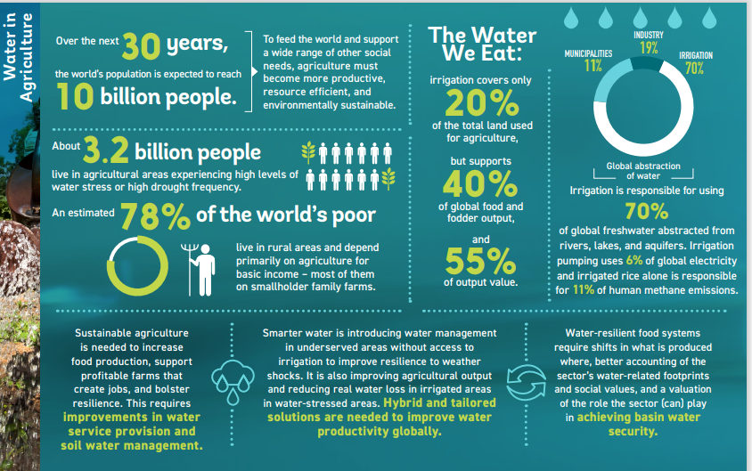
Project Overview
High population growth rates, increased food consumption and expansion of irrigated farm land are putting pressure on water and land resources globally (Rosa et al., 2020).
With 92% of UK landmass having at least 4G coverage, the UK is a feasible location for initial application of this system (GOV.UK, 2022)
Smart Irrigation Management System;
Optimising water use in agriculture.
Provide recommendations through machine learning technology.
Provide a hardware and software based solution, tailored to specific farming requirements.
UN sustainable goal 6 contributing to a sustainable future through effective water management.
Contributes to UN sustainability goal 12, by contributing to sustainable agricultural practice.
Source: Water in Agriculture: Towards Sustainable Agriculture(2021)
World Bank Group

Slide 5
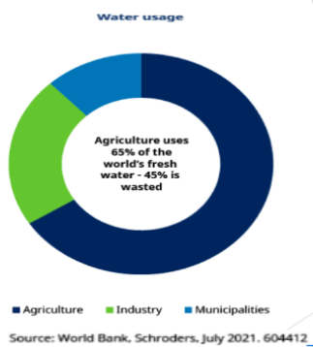
Problem Statement
According to the World Bank (Bank, 2020), farms utilising irrigation practices have proved to be twice as productive compared to rainfed agriculture.
However, inefficient irrigation practices can lead to the following;
Excessive water wastage
Insufficient crop yield
Land degradation
Poor crop quality
Strain on local ecosystems
Drought
Source: World Bank, Schroders (2021)
Notes:
According to the World Bank (Bank, 2020), irrigation practices have proved to be twice as productive compared to rainfed agriculture, however inefficient irrigation practices can lead to major global issues such as; poor crop yield and excessive water wastage.

Slide 6
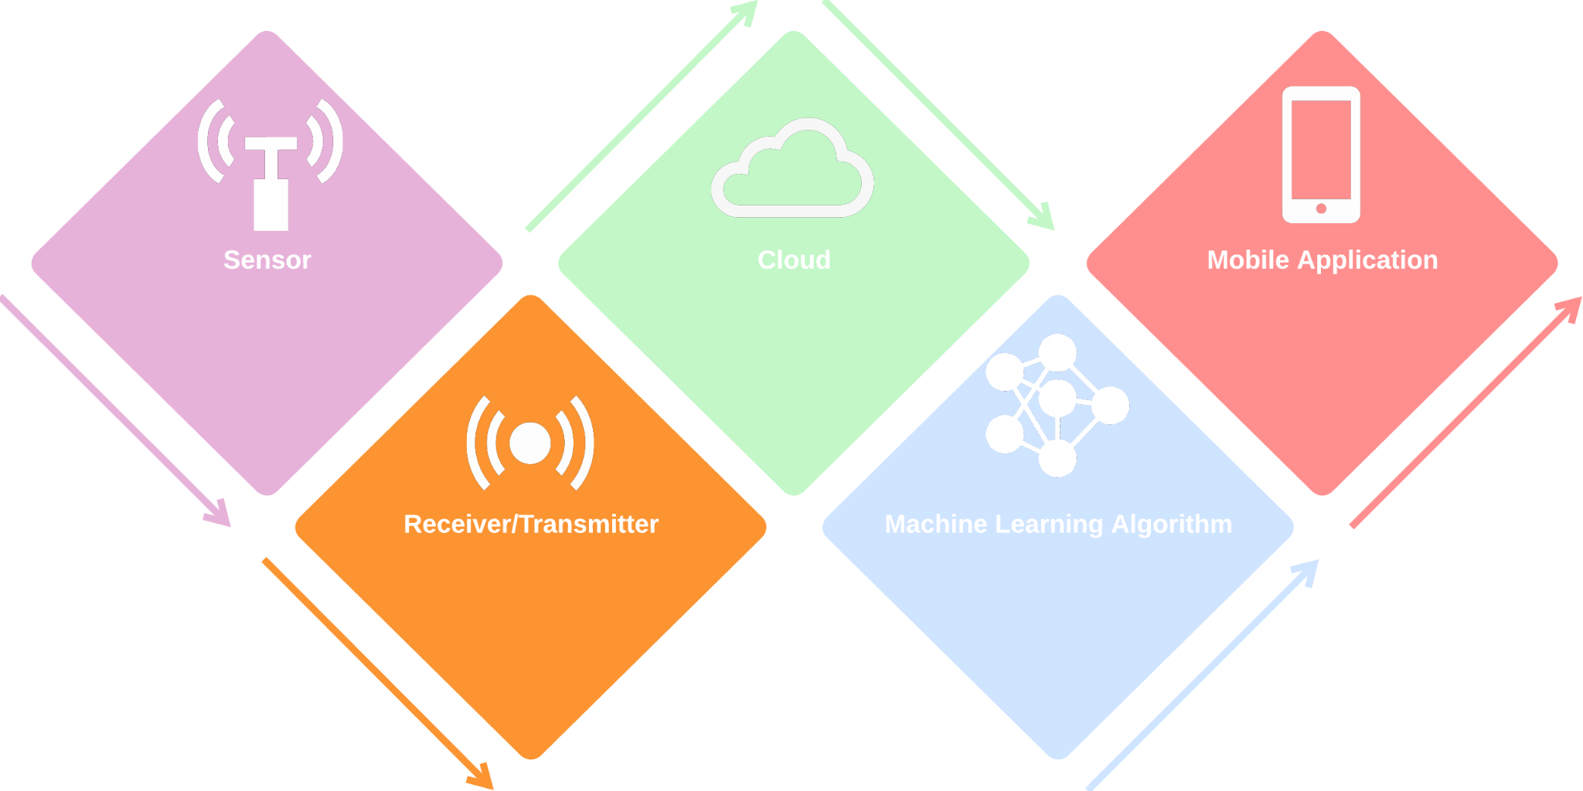
Application Flow
CLOUD
Data transmitted from receiver to cloud via cellular.
IRRIGATION PREDICTIONS
Intuitive and user friendly mobile application.
SENSOR
Sensor transmits data to the receiver via Wireless sensor network (WSN).
IRRIGATION PREDICTIONS
Multiple data sources processed through machine learning algorithm.
Fig 1.1: Application Flow

Slide 7
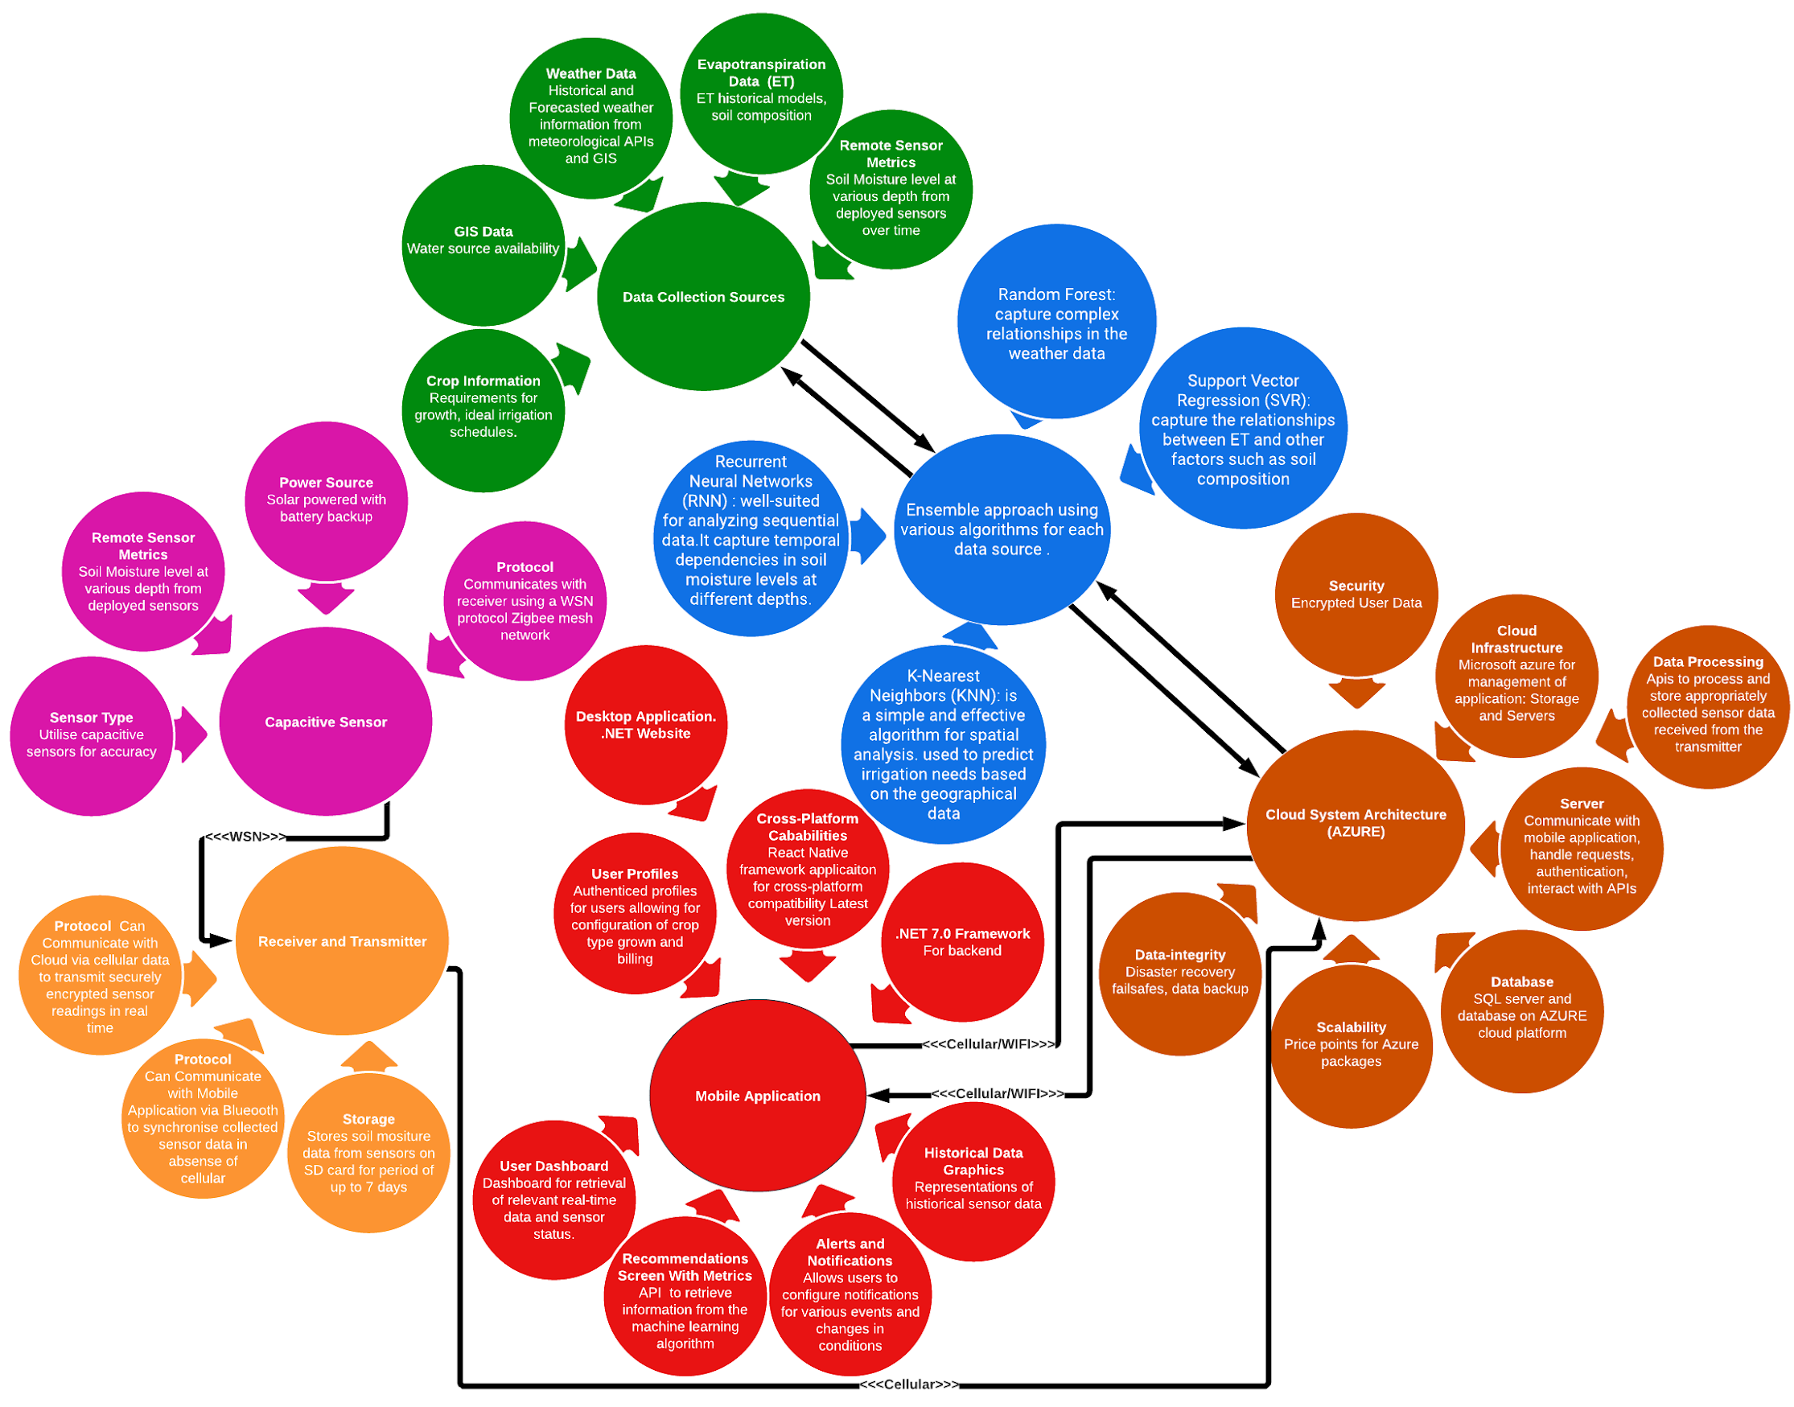
System Architecture
Fig 1.2: Solution Architecture
Notes:
“holds a key place, whereby it can assist key stakeholders in making precise decisions regarding the conditions on their farms””In terms of accuracy, it is evident that RF performs the best, with a score of 97.18%”(Thilakarathne, Bakar, Abas, & Yassin, 2022)

Slide 8
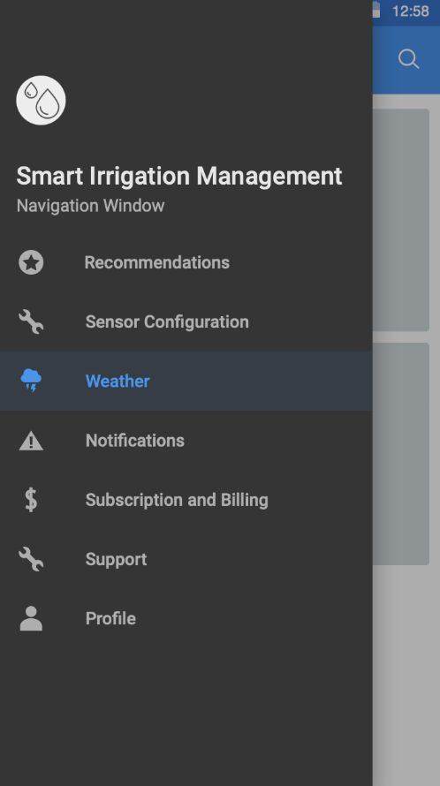
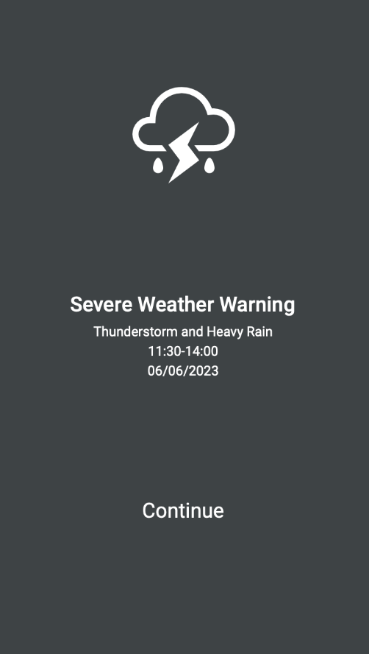
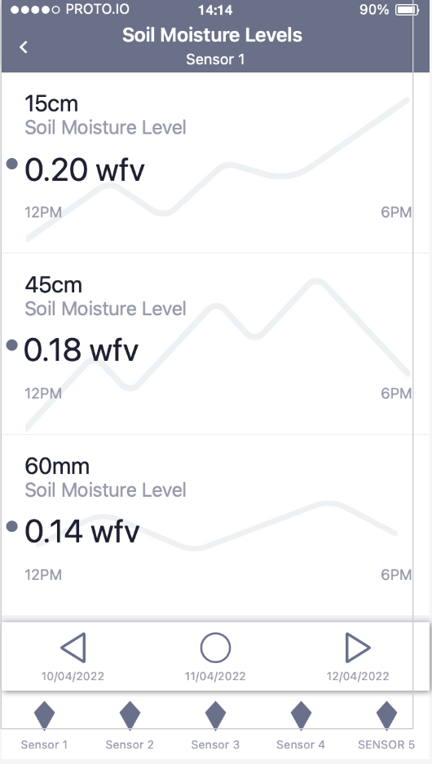
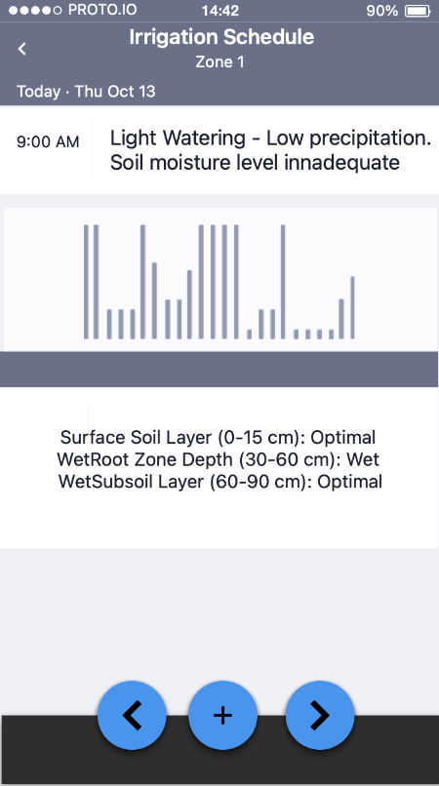
Application Prototype
Fig 1.3: Application Prototype

Slide 9
Functional Analysis
Functional Requirements
Mobile Application
User Registration.
User Billing and Subscription management.
View ML driven irrigation recommendations.
Realtime/Historical infographics
User configured Notifications
Receiver/Transmitter and Sensor
Measure soil moisture levels using capacitive sensors.
Data sent from sensors to receivers
Cloud System Infrastructure
Must support the integration of multiple data source apis for machine learning processing.
External Data APIs
Must display relevant weather information: Temperature, humidity, wind speed, and weather event tracking.
Water source information
Crop type information API: Growth stages, Crop coefficient
Soil Information API: User-input for soil type.
Non-functional Requirements:
Performance
Sensors must be accurately calibrated to measure soil moisture levels.
Application should be able to cope with a large volume of users without noticeable performance impact.
Portability
Application must be usable in regions with cellular data.
Scalability
Application must be able to support up to 500,000 simultaneous users.
Compatibility
Compatible on both IOS and Android devices, potentially using React Native framework.
Availability
Accessible 24/7 on Mobile and Desktop devices.
System must have extensive disaster recovery and backup plans in the event of server shutdown.
Security
Secure storage of sensitive user data.
Compliance
System must comply with UK regulations for farming management tools and Data Protection regulation.
Table 1.1: Functional Analysis
(Kesavan, 2023)
Notes:
Mobile Application
Self registration by farmers,reset password
Users must be able to set up payment subscriptions using payment gateway to use application.
Users must be able to view recommendations on a dashboard that receives information from the cloud and driven by the ML algorithm.
System must display real-time sensor information as well as realtime and historical weather/evapotranspiration data.
Users must be able to view historical sensor data to recognise patterns in water availability and weather conditions.
System must be able to provide custom notifications to the uses mobile device in the event of specific events including Soil moisture falls below a certain threshold, or a severe weather event is predicted.
Chosen/Developed weather API must display relevant weather information: Temperature, humidity, wind speed, and weather event tracking.
Type of water source eg well, rain harvest, lake ,borewell & water quantity required and outlet info eg valves /taps/sprinkler no.
Non-functional Requirements:
Performance
Sensors must be accurately calibrated to measure soil moisture levels.
Portability
Application must be usable in regions with cellular data.
Scalability
-Application should be able to cope with a large volume of users without noticeable performance impact.
Application must be able to support up to 500,000 simultaneous users.
Compatibility
Compatible on both IOS and Android devices, potentially using React Native framework.
Availability
Accessible 24/7 on Mobile and Desktop devices.
System should have extensive disaster recovery and backup plans in the event of server shutdown.
Security
Secure storage of sensitive user data.
Compliance
System must comply with UK regulations for farming management tools and Data Protection regulation.

Slide 10
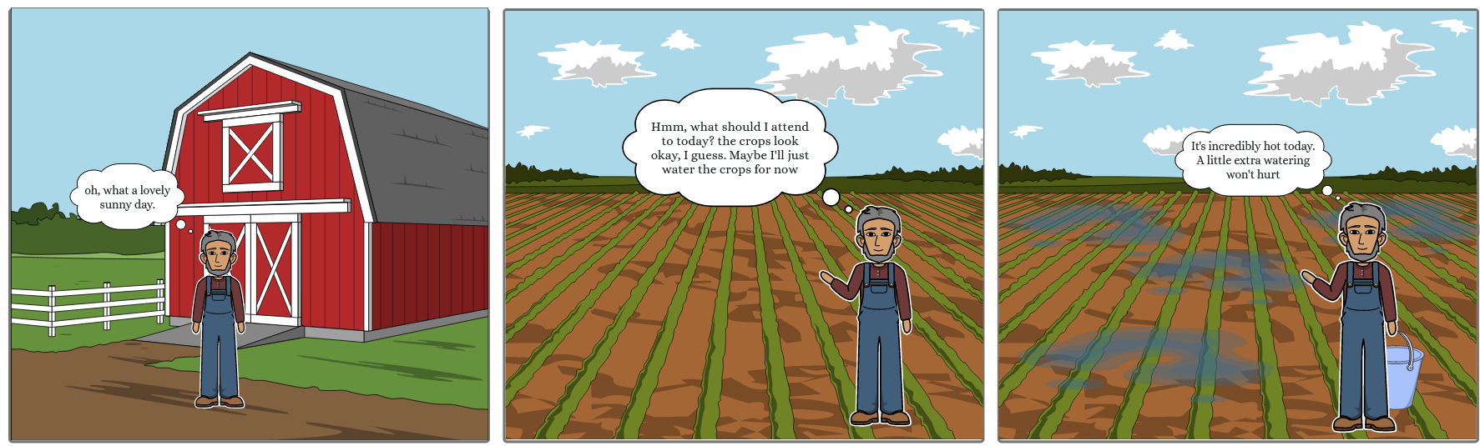
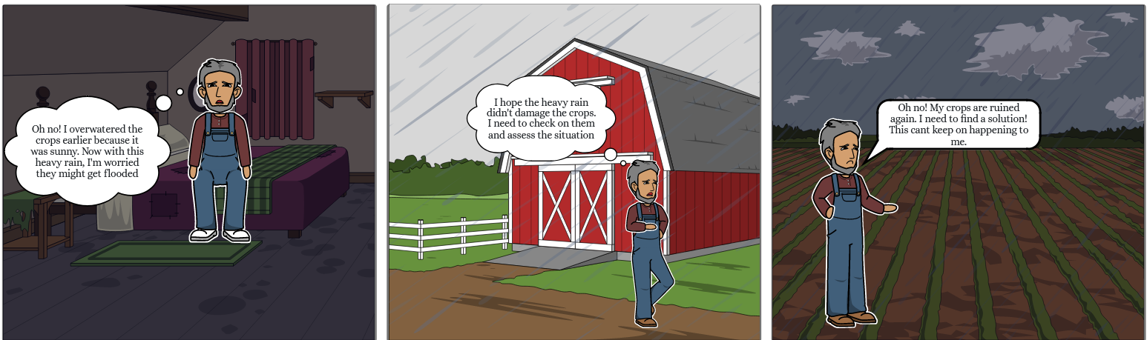
Notes:
Problem Demonstration
Slide 1, The first slide shows a farmer starting his day and enjoying the great weather.
Slide 2, The farmer arrives at his farm but is unsure about the actions he should take for his soil and With no clear plan, he decides to water them since it's a sunny day.
Slide 3, the farmer ends up overwatering his soil hoping due to the scorching heat
Slide 4, In the next slide, the farmer is going to bed with a troubled mind as he realizes that he has unintentionally overwatered his crops, and to make matters worse, the weather has changed and it's now raining outside.
Slide 5, The following morning, the farmer anxiously goes to check on his crops.
Slide 6, Finally the farmer reaches his farm only to find that his crops have been ruined due to insufficient soil practices and moisture levels

Slide 11
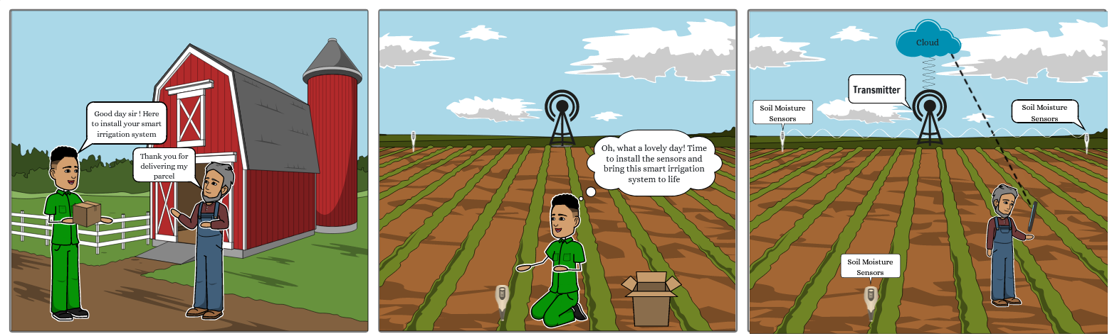

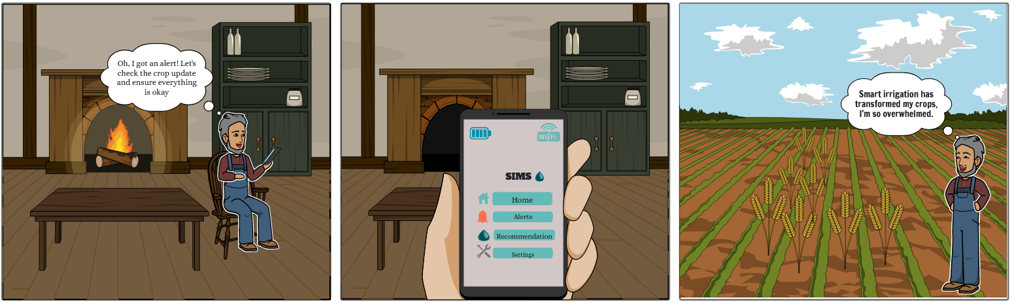
Cellular
Notes:
Solution demonstration
To avoid such problems and to support the farmers, we have developed a comprehensive package. Our packages include sensors and receivers that are specifically designed to meet the needs of the farmer.
Once our packages are delivered to the farmers, a third-party installation service will be in place to ensures that the sensors and receivers integrated into the farmers' crop fields. To ensure accurate data collection and reliable performance.
From a successful installation, the sensors immediately begin their work. They will collect crucial factors such as soil moisture levels, water stress, and irrigation needs. This vital information is then transmitted to the receivers, which securely relay the data to the cloud.
From which with the help of machine learning algorithms, our cloud-based system analyses the collected data in real-time. The machine learning algorithms will process the information and generate intelligent solutions tailored to the specific needs of each farmer's crop field. These solutions are then seamlessly communicated to the farmer through our user-friendly mobile application.
Next slide shows, that the farmer can access the recommendation from the comfort of their homes, By implementing these recommendations and following the recommended irrigation processes, we hope to provide the best recommendation to irrigate farmers crop.

Slide 12
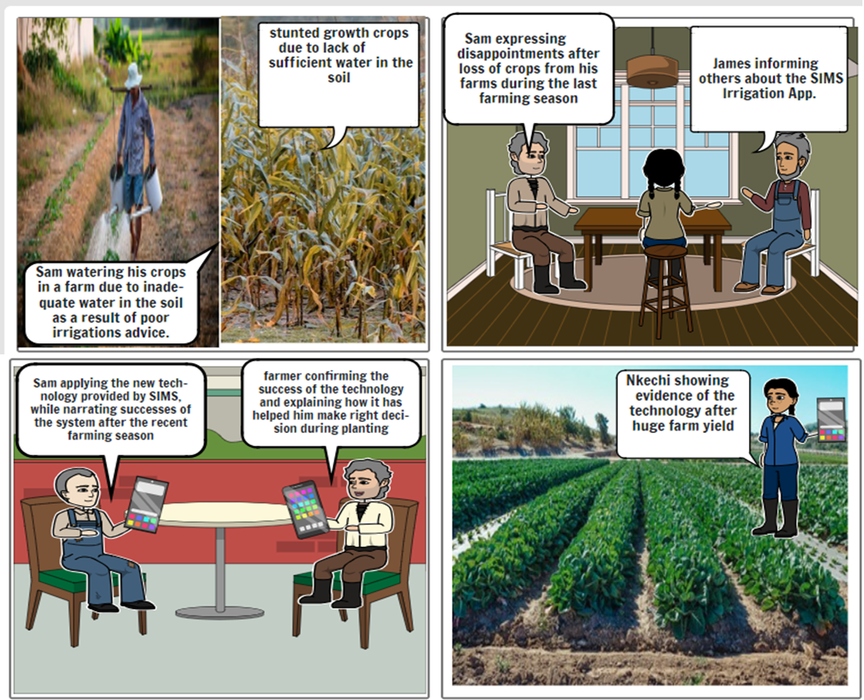
Storyboard

Slide 13
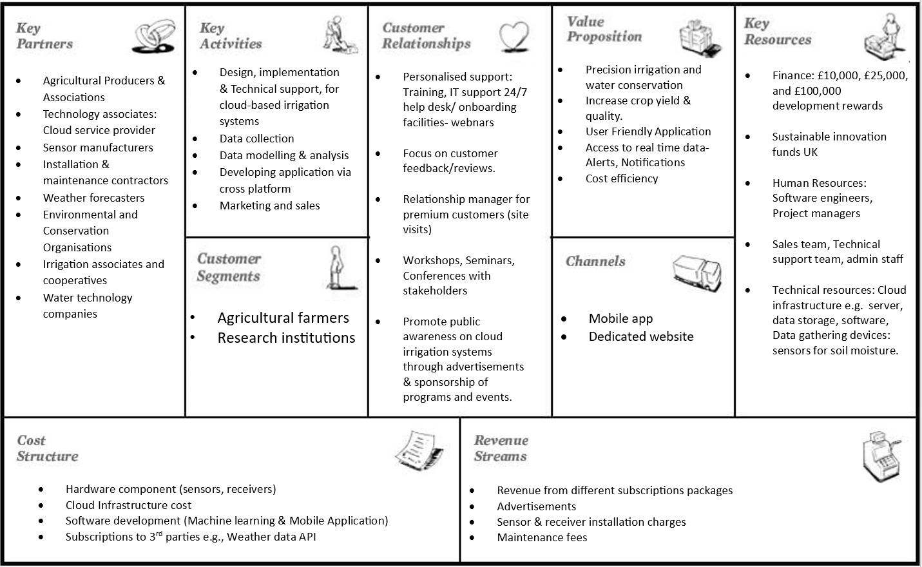
Business Model Canvas
(Osterwalder, 2010)
Table 1.2: Business Model Canvas

Slide 14
MoSCoW Analysis
(Quinn, 2017)
Table 1.3: MoSCoW Analysis
Budget | Must have (Mo) | Should have (s) | Could have (co) | Will not have (W)
£10,000 | Technical Equipment eg sensors, receivers Machine learning algorithm for irrigation prediction Alerts/ Notifications Phone & email customer support Limited API Data sources Azure Database Cellular 4G £7,000 | Crop, soil, weather information System updates and backups Alerts/ Notifications User friendly features Phone & email customer support 100m wireless sensor GIS Data - Weather Information £2,500 | GIS Data - water scarcity information alert. £500 | 24/7 online customer support Unlimited API Data sources . Dedicated website with dashboard Relationship manager for premium clients
£25,000 | All features of £10,000 Budget Crop, soil, weather information System updates and backups Mobile Application Development. Azure Server (Cloud Platform) £16,000 | GIS Data - water scarcity Advertisement campaign 24/7 online customer Support 100m Zigbee Wireless Sensor £6500 | Programmable Irrigation Timer chart. Unlimited API Data source. £2500 | Delivery & Installation services Relationship manager for premium clients
£100,000 | All features of £25,000 Budget All Data Sources Dedicated website with dashboard System updates and Backups. Tailored support solutions Delivery/installation services Cellular 4G and 5G £ 65,000 | -GIS data - water Scarcity notification subscription. -5000m wireless sensor -100m Zigbee Wireless Sensor -Programmable Irrigation Timer Chart £ 25,000 | Microsoft Azure Infrastructure scalability Data analysis infographics. £10,000 | Relationship manager for premium clients Network solutions- Local Network infrastructure programs

Slide 15
Risk Assessment Log
ID | Description | Probability | Impact | Risk Category | Response
1. | Sensor Inaccuracy | Medium | High | Data Integrity Risk | Calibration of sensors to ensure collected soil moisture data is accurate and provides valid data for the machine learning algorithm
2. | Customer data breach | Medium | High | Security/ Privacy Risk | Integrate security measures like encryption, and safe payment gateways to protect user information for user subscriptions and unauthorised access
3. | Integration challenges with infrastructure - Use of external APIs | Low | High | Operational Risk | Keeping software up to date, Communicating with service providers for data collection APIs eg meteorological APIs
4. | As the service grows, the system may not cope with increased volume of users | Low | High | Scalability Risk | Establishing scalable system architecture, to handle scalable user base, through Azure cloud services.
5. | Machine learning Prediction accuracy | Low | High | Data Integrity Risk | Using parameter tuning for models, extensive algorithm testing for irrigation management system
6. | Inability to adapt to new solution - Application and hardware | Low | Low | Adaptability | Provide extensive support resources like online support to farmers eg customer support line and regularly update tutorials
7. | Technical failure - Server downtime issues | Low | High | Operational Risk | Disaster recovery processes: regular systems upgrade and backup systems will be implemented to ensure data is safe guarded.
8. | Standard compliance | Low | Medium | Legal risk | Adhering to international standards and data regulation policies of the state
(Linh et al., 2019)
Table 1.4: Risk Assessment Log

Slide 16
Technical Feasibility
Items | Requirements
Cloud Infrastructure | Server - Azure Cloud Platform Database - Azure SQL Database
Machine Learning Algorithm | Programming Language - Python. Libraries and tools: numPy, Scikit-learn library (Thilakarathne et al, 2022)
Mobile Application | Back end: ASP .Net framework. Front-end: React Native. OS compatibility: Android and IOS Programming Language: Python libraries Libraries and Tools: React Native Elements, React Navigation
Website | Back end Framework: ASP .Net framework Front end Framework: .Net framework Browsers: Compatible with major browsers.
Soil Moisture Sensors | WSN Protocol - Zigbee Mesh Network Measuring Method - Capacitive soil moisture sensors, multiple depths Transmission frequency - Real Time Power source - Solar Panel and backup battery.
Receiver/Transmitter | Protocol - Cellular Data (4G/LTE or 5G) via SIM card to communicate with the cloud, MQTT subscriber for sensor nodes. Power Source - Solar Panel and backup battery
Payment Gateways | Online payment gateways/platforms - Google Play, Stripe, PayPal
External API/ Data Sources | Weatherstack API - Realtime and historical Weather Data Soil data - National soil maps EUDASM Evapotranspiration data - Met Office APIs
Table 1.5: Technical Feasibility
(Fakhreddine & Faye, 2020)
Notes:
Additional libraries and tools: numPy, Scikit-learn library (Thilakarathne, Bakar, Abas, & Yassin, 2022).
Mobile Front-end: React Native (Connected to back-end via exposed API endpoints) (Cross Platform)
React Native Elements - UI components.
React Navigation - Intuitive navigation.
Soil Moisture sensors
Protocol - MQTT (publisher)
Measuring Style - Capacitive soil moisture sensor. Suitable for different soil types, affordable and accurate.
Receiver/transmitter
Protocol - Cellular Data (4G/LTE or 5G) via SIM card to communicate with the cloud, MQTT (subscriber) to receive data from the sensor nodes.
Payment gateways - Secure and well established.
Weatherstack API - Business tier £80 per month. Delivers real-time and historical weather information from around the globe. Offers flexible pricing tiers.

Slide 17
LSEPI Analysis
Stakeholder | Concern | Issue | LSEPI
Agricultural producers | Disclosure of farmers personal information & location details Misuse of personal information for external purposes not addressed or provided consent for. Protection from misuse of personal information for fraudulent purposes Stakeholder concern over application meeting Data protection laws, and concerns over ownership/use of provided data. Reliability and accuracy of the system and does the app meet the farmer’s expectations Unfair business contracts between the farmers and usl | Is data storage, processing & protection of personal data including consent requirements of farmers, data breaches , as per the General Data Protection Regulation (GDPR-2018) and UK Data protection Act (DPA-1998)? Who is accountable if the system malfunctions or there is inaccurate analysis? Is the business contract between the vendor and us fair and does it take into consideration the consumer rights in relation to digital content and online services per the Consumer Rights Act 2015 and the Unfair Contract Terms Act 1977? | Legal, Ethical, Social, Professional
Technical Associates e.g Cloud Service Providers | Cloud hosting data center outages eg internet black out , disruptions Cyber attacks leading to data becoming encrypted and unavailable, leaks of sensitive information e.g farmers and irrigation schedules The choice of ML algorithms used and their level of precision in yielding unbiased results. Provision of unfair business contracts between the vendors and SIMS. | Is the processing of data within the cloud system & data subject rights as per the General Data Protection Regulation (GDPR-2018) and UK Data protection Act (DPA-1998)? Is the cloud system and data protected from “unauthorised access with the intent to commit or facilitate commission of further offences “ as per The Computer Misuse Act 1990?. Is the business contract between the vendor and us fair and does it take into consideration the consumer rights in relation to digital content and online services per the Consumer Rights Act 2015 and the Unfair Contract Terms Act 1977? | Legal, Ethical, Professional
Manufacturers of sensors & receivers | Competition from other market players Compatibility and performance of the sensors in relation to the weather condition, soil texture Availability of sensors with in time frame- Production capabilities. Unauthorised access to sensor and receiver data Manufacturers health and safety regulations at work | Do the manufacturers adhere to the Electrical Equipment (Safety) Regulations 2016? Compliances with the The Computer Misuse Act 1990 - “unauthorised modification to computer materials i.e ”. Unauthorised sensor data modification. Do the manufacturers maintain a safe working environment for their employees i.e adhering to the Health and Safety at Work Act 1974? | Legal, Social, Ethical Professional
Project Team | Ideological differences causing the team to work away from the project values The level of knowledge and expertise of the team | Will the team be able to deliver the project with the available scope of resources? Will the team be able to deliver the project with the level of knowledge & expertise they have? Is the team abiding by the British Computer Society code of conduct? | Professional, Ethical
(Tavani, 2009)
Table 1.6: LSEPI Analysis Table

Slide 18
LSEPI Analysis
(Floridi & Dawsonera, 2010)
Stakeholder | Concern | Issue | LSEPI
Weather forecasters | -Accuracy in weather forecasting reports -Localized weather variation in the same geographic area -Their level of openness and transparency in sharing information | Do the weather forecasters conform to the data protection and storage policies of General Data Protection Regulation (GDPR-2018) and UK Data protection Act (DPA-1998)? Practices between our organisation and external providers must be coordinated in line with The UK data protection act (DPA-1998). | Legal, Professional,Ethical
Irrigation Associates and Cooperatives | -The performance of the system to avoid wastage of water -Flexibility and customisation of the system to suit the different needs of farmers -Onboarding facilities to setup the system -Misuse of irrigation data related to water usage, crop data, irrigation practices -Who actually owns the irrigation data in the cloud platform? | Is the system complaint with the Water Environment Regulations 2017. They establish water management objectives; including practicing relevant irrigation system? Is data storage, processing and protection of data including data breaches , as per the General Data Protection Regulation (GDPR-2018) and UK Data protection Act (DPA-1998)? | Legal and Ethical issues.
Environmental & Conservation Associations | -Environmental concerns regarding the use of sensors and receivers on soil eg do they contaminate the soil | Are the sensors and receivers manufactured with consideration to the Environment Protection Act 1990? | Ethical, Social
Water Services Regulation Authority | -Providing good quality water for irrigation farming - Is the system sustainable and reduce water wastage on farms? | Does the cloud system deliver a sustainable solution to efficient water management while adhering to the standards of Water Service Regulation Authority -UK? | Ethical , Social
Online Payment Platforms | Disclosure of farmers bank account details | Data security breaches releasing sensitive client information. UK Data protection Act (DPA-1998). Financial services (Banking Reform) Act, 2013. | Legal

Slide 19
Thank you for supporting
sustainable innovation

Slide 20
References
Agrii. (2021, April 7). Soil Moisture Monitoring - Agrii - connecting agri-science with farming. https://www.agrii.co.uk/products-services/soil-moisture-monitoring/
Bank, W. (2020). The World Bank Annual Report 2020. The World Bank: Washington, DC, USA,
EUDASM. (2023). National Soil Maps (EUDASM). ESDAC. https://esdac.jrc.ec.europa.eu/resource-type/national-soil-maps-eudasm?field_data_continent_tid_selective=1266&field_data_cont_coverage_value=0
Financial Services (banking reform) act 2013 - legislation.gov.uk. (2013). Retrieved from https://www.legislation.gov.uk/ukpga/2013/33/contents/enacted
GOV.UK. (2022, April 6). Rural Mobile coverage in the UK: Not-spots and partial not-spots. Parliament.UK. https://commonslibrary.parliament.uk/research-briefings/sn07069/
Thilakarathne, N. N., Bakar, M. S., Abas, P. E., & Yassin, H. (2022). A cloud enabled crop recommendation platform for machine learning-driven precision farming. Sensors, 22(16), 6299. doi:10.3390/s22166299
The Business Model Canvas - 9 Steps to Creating a Successful Business Model. . ().[Video/DVD] https://www.youtube.com/watch?v=IP0cUBWTgpY
Fakhreddine, B. B., & Faye, A. (2020). A technical feasibility study of a hybrid wind/hydro power-system to provide firm power source and water for irrigation for the Uppermost Maten region–Lebanon.

Slide 21
References (Contd)
Floridi, L., & Dawsonera. (2010). The Cambridge handbook of information and computer ethics. Cambridge University Press.
Kesavan, S. (2023). Functional analysis. Springer Nature.
Linh, N. D., Hung, P. D., Diep, V. T., & Tung, T. D. (2019). Risk management in projects based on open-source software. Paper presented at the Proceedings of the 2019 8th International Conference on Software and Computer Applications, 178-183.
Osterwalder, A. (2010). Business Model Generation: A Handbook for Visionaries, Game Changers, and Challengers (1st edition ed.). Wiley.
Quinn, M. J. (2017). Ethics for the information age (7th edition ed.). Pearson.
Rosa, R., Chiarelli, C., Rulli, R., Dell’Angelo Dell’Angelo, & D’Odorico D’Odorico. (2020). Global agricultural economic water scarcity. Science Advances, 6(18), eaaz6031. 10.1126/sciadv.aaz6031
Tavani, H. T. (2009). Ethics and technology: controversies, questions, and strategies for ethical computing (3rd ed ed.). Wiley.
United Nations. (2023). Water and sanitation - united nations sustainable development. United Nations. https://www.un.org/sustainabledevelopment/water-and-sanitation/
UN (2022) ‘Goal 12 ensure sustainable consumption and production patterns’, Sustainable Development Goals [Preprint]. doi:10.5040/9781509934058.0018.
Water in Agriculture : Towards Sustainable Agriculture (English). Washington, D.C. : World Bank Group. http://documents.worldbank.org/curated/en/875921614166983369/Water-in-Agriculture-Towards-Sustainable-Agriculture

Slide 22
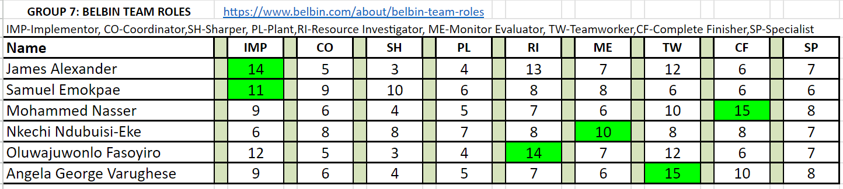
APPENDIX A
Tables
Table 1.1: Functional Analysis
Table 1.2: Business Model Canvas
Table 1.3: MoSCow Analysis
Table 1.4: Risk Assessment Log
Table 1.5 Technical Feasibility
Table 1.6: LSEPI Analysis Table
Figures
Fig 1.1: Application Flow
Fig 1.2: Solution Architecture
Fig 1.3: Application Prototype

Slide 23
APPENDIX B
Name | Belbin Role | Technical Skills | Strength
Nasser Mohammed | Complete Finisher | Highly skilled Visualization Expert, possess extensive experience working with the .Net framework, delivers impactful visualizations that facilitate informed decision-making | I have an analytical mindset which comes from my background in MSC. Big Data Analytics, I am able to quickly identify strengths,weakness and rectify errors in our project and suggest recommendations.
Samuel Emokpae | Coordinator | Proficient in front-end development React Native, C# and .NET framework, Github | With just few days of interaction, he was able to get a good understanding of each members capabilities and confidently delegate responsibilities accordingly. He also puts emphasis on clarifying our project goals so that we are on the right track .MSc.Big Data Analytics
James Alexander | Implementer | Proficient in .Net framework , frontend web and mobile application development, web security expert, expert in RESTful APIs | I am able to work in a systematic and organised manner, with a strong ability of turning ideas into actions. I strive to look for practical solutions that can be implemented effectively.

Slide 24
APPENDIX C
Nkechi Ndubuisi-Eke | Monitor Evaluator | Familiarity with data analysis and interpretation techniques to optimize irrigation techniques, experience in utilizing remote monitoring systems, wireless communication protocols for real time monitoring. | She capable of looking at all options available to us , make a comparative analysis and guide us to a right choice in terms of logical decision making. MSc. Information Management Technology
Oluwajuwonlo Fasoyiro | Resource Investigator | Proficient in .NET Framework , C#, Python, Machine learning, experienced telecom specialist , Microsoft azure specialist. Knowledge of sensor. | Driven by curiosity , he is always exploring new ideas,concepts, patterns and trends.And keeping us informed with latest updates, this supports our decision making process in the project. MSc. Big Data Analytics.
Angela George Varughese | Team Worker | Possesses effective communication skills, knowledge of climate change and it on irrigation system, skilled in water resources management and conservation practices | She ensures the involvement and participation of all members of the team by effectively communicating. She has a good ability to work collaboratively and respectfully with team mates.Msc Big Data Analytics

